Slide 1
Reflections on the Coordinate Plane

Slide 2
Objective
I can reflect figures on a coordinate graph and explain the relationship between coordinates.

Slide 5
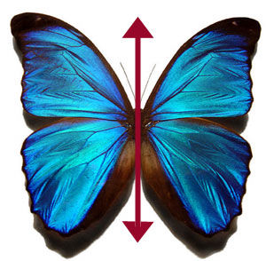
Reflections
A reflection flips a figure across a line to create a mirror image.

Slide 6
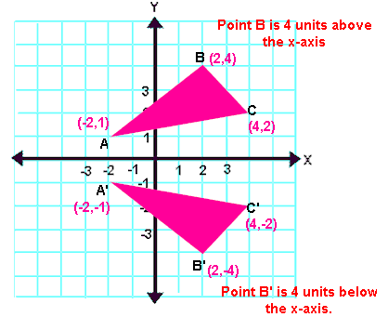
Example

Slide 7
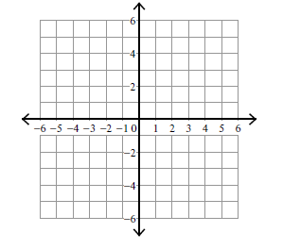
Reflection y- axis
Remember the y axis is the vertical axis.
Count the distance from each point to the y-axis.
Count the same distance on the other side.
Plot your image points.
A(-2, 5) → B(-4, 1) →
A
A’
B
B’
*Notice the numbers stayed the same, but the sign of the x value changed.

Slide 8
Reflection rules across y-axis:
When you reflect a point across the y-axis, the y-value remains the same, but the x-value is transformed into its opposite.
The reflection of the point (x, y) across the y-axis is the point (-x, y).

Slide 9
Reflection x- axis
Remember the x axis is the horizontal axis.
Count the distance from each point to the x-axis.
Count the same distance on the other side.
Plot your image points.
A(2, -5) → B(4, -1) →
A’
B’
B
A
*Notice the numbers stayed the same, but the sign of the y value changed.

Slide 10
Reflection rules across x-axis:
When you reflect a point across the x-axis, the x-value remains the same, but the y-value is transformed into its opposite.
The reflection of the point (x, y) across the x-axis is the point (x,-y).

Slide 11
Practice
Reflect across the y-axis
A(-3, 5)→
B(-5, 2)→
C(-2, 2)→
A
B
C

Slide 12
Practice
Reflect across the x-axis
A(2, 4)→
B(5, 4)→
C(5, 1)→
D(2, 2)→
A
B
D
C

